Slide 1


Page 1 /58
Prepared by: Stephy
Date: 11.03.2011
TOP GLOVE, TOP QUALITY, TOP EFFICIENCY
GOOD HEALTH, SAFETY FIRST & BE HONEST
PRESENT BY:
JIMMY /STEPHY
DATE:
09/02/2012
TIME: 3.30PM
-
4.30PM

Slide 2

Page 2 /58
Prepared by: Stephy
Date: 11.03.2011
TOP GLOVE, TOP QUALITY, TOP EFFICIENCY
GOOD HEALTH, SAFETY FIRST & BE HONEST
ITS
IMPLEMENTATION

Slide 3
Page 3 /58
TOP GLOVE, TOP QUALITY, TOP EFFICIENCY
GOOD HEALTH, SAFETY FIRST & BE HONEST
Prepared by: Stephy
Date: 11.03.2011
MARKETING
Proforma Invoice
CRF
CUSTOMER / BANK (A/C)
Payment
Feedback
Credit / Debit Note
Letter of Credit
DOCUMENTATION
Shipping Instruction
Commercial Invoice
Packing List
ERP SYSTEMS (ENTERPRISING RESOURCES PLANNING)
SHIPPING
Booking Vessel (CIF)
Vessel nomination (FOB)
Pull in / out container
DOCUMENTATION / BANK / CUSTOMER
a. Documents presentation / negotiation
THIRD PARTY / DOCUMENTATION
Certificate of Origin
Bill of Lading
QUALITY ASSURANCE
  Test / Quality Report
  Conformity Cert
  Third party inspectiom
PRODUCTION / WAREHOUSE
Cargo readiness
Stuffing
Delivery Order

Slide 4

Page 4 /58
Prepared by: Stephy
Date: 11.03.2011
TOP GLOVE, TOP QUALITY, TOP EFFICIENCY
GOOD HEALTH, SAFETY FIRST & BE HONEST

Slide 5

Page 5 /58
Prepared by: Stephy
Date: 11.03.2011
TOP GLOVE, TOP QUALITY, TOP EFFICIENCY
GOOD HEALTH, SAFETY FIRST & BE HONEST

Slide 6
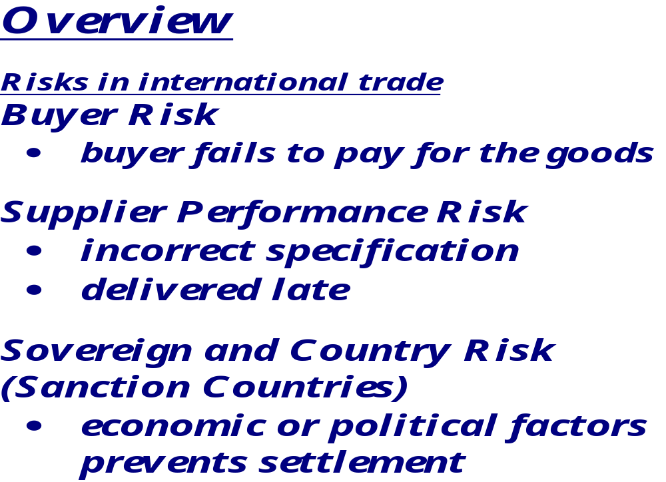
Page 6 /58
TOP GLOVE, TOP QUALITY, TOP EFFICIENCY
GOOD HEALTH, SAFETY FIRST & BE HONEST
Prepared by: Stephy
Date: 11.03.2011

Slide 7
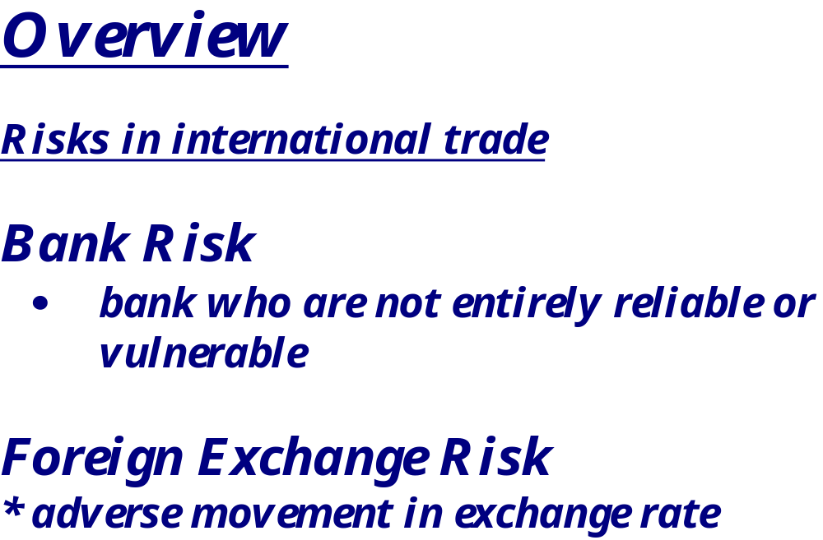
Page 7 /58
TOP GLOVE, TOP QUALITY, TOP EFFICIENCY
GOOD HEALTH, SAFETY FIRST & BE HONEST
Prepared by: Stephy
Date: 10 May 2010

Slide 8
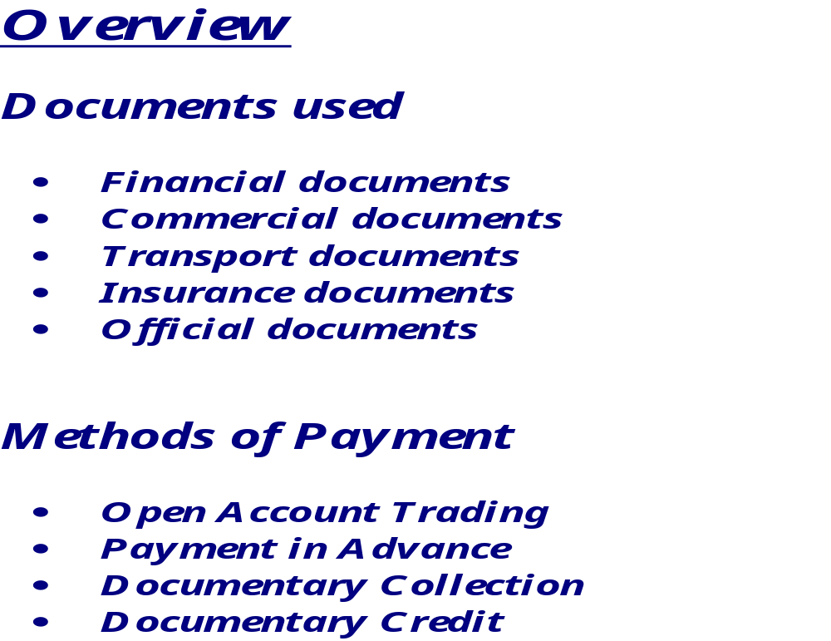
Page 8 /58
TOP GLOVE, TOP QUALITY, TOP EFFICIENCY
GOOD HEALTH, SAFETY FIRST & BE HONEST
Prepared by: Stephy
Date: 11.03.2011

Slide 9

Page 9 /58
Prepared by: Stephy
Date: 11.03.2011
TOP GLOVE, TOP QUALITY, TOP EFFICIENCY
GOOD HEALTH, SAFETY FIRST & BE HONEST
Goods
Importer
Exporter
$

Slide 10

Page 10 /58
TOP GLOVE, TOP QUALITY, TOP EFFICIENCY
GOOD HEALTH, SAFETY FIRST & BE HONEST
Prepared by: Stephy
Date: 11.03.2011
$
Importer
Exporter
Goods

Slide 11
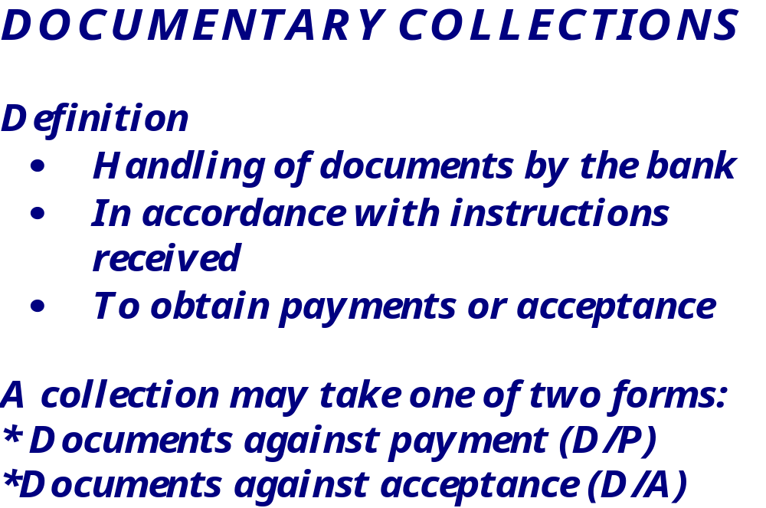
Page 11 /58
TOP GLOVE, TOP QUALITY, TOP EFFICIENCY
GOOD HEALTH, SAFETY FIRST & BE HONEST
Prepared by: Stephy
Date: 11.03.2011

Slide 12
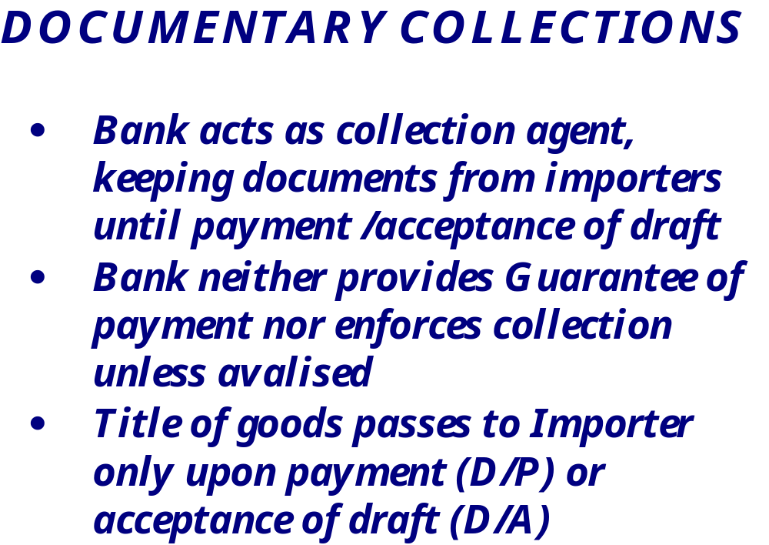
Page 12 /58
TOP GLOVE, TOP QUALITY, TOP EFFICIENCY
GOOD HEALTH, SAFETY FIRST & BE HONEST
Prepared by: Stephy
Date: 11.03.2011

Slide 13
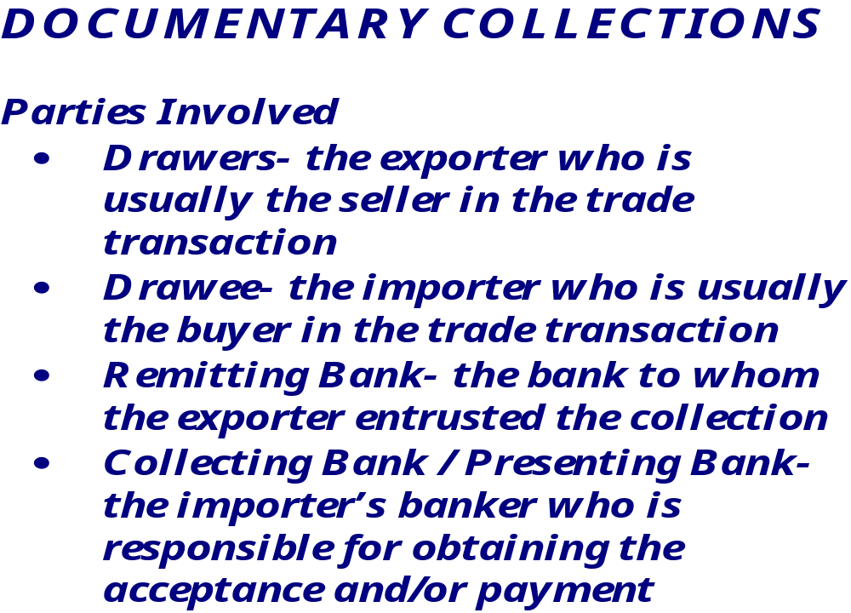
Page 13 /58
Prepared by: Stephy
Date: 11.03.2011
TOP GLOVE, TOP QUALITY, TOP EFFICIENCY
GOOD HEALTH, SAFETY FIRST & BE HONEST

Slide 14

Page 14 /58
TOP GLOVE, TOP QUALITY, TOP EFFICIENCY
GOOD HEALTH, SAFETY FIRST & BE HONEST
Prepared by: Stephy
Date: 11.03.2011
Exporter
Importer
Documents
$$
Remitting Bank
Collecting Bank

Slide 15
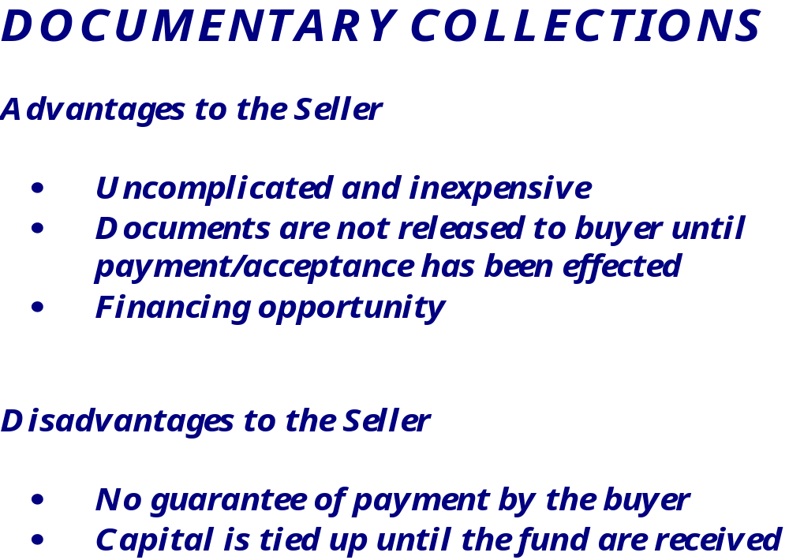
Page 15 /58
TOP GLOVE, TOP QUALITY, TOP EFFICIENCY
GOOD HEALTH, SAFETY FIRST & BE HONEST
Prepared by: Stephy
Date: 11.03.2011

Slide 16
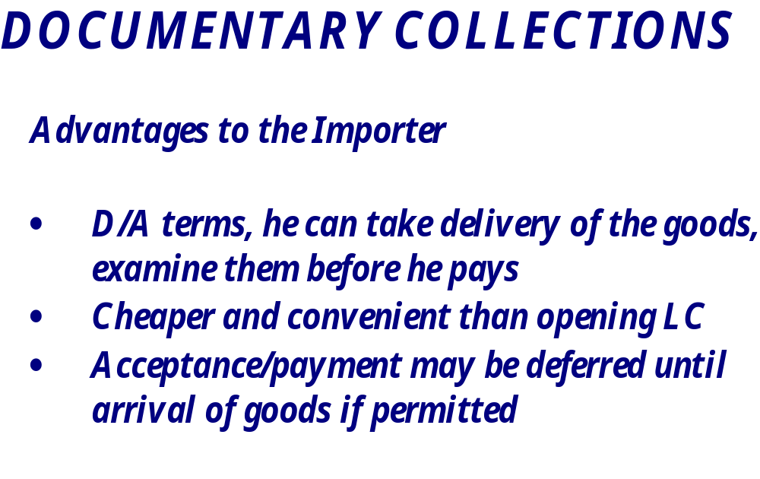
Page 16 /58
TOP GLOVE, TOP QUALITY, TOP EFFICIENCY
GOOD HEALTH, SAFETY FIRST & BE HONEST
Prepared by: Stephy
Date: 11.03.2011

Slide 17
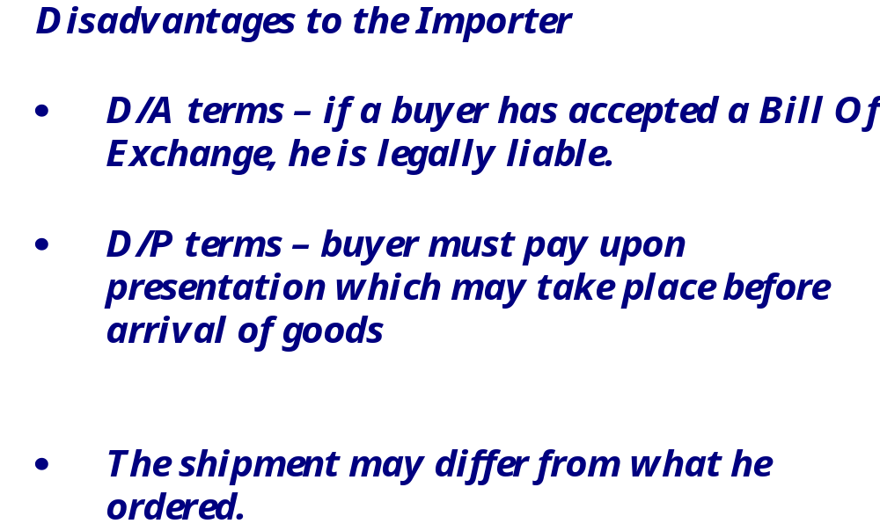
Page 17 /58
TOP GLOVE, TOP QUALITY, TOP EFFICIENCY
GOOD HEALTH, SAFETY FIRST & BE HONEST
Prepared by: Stephy
Date: 11.03.2011

Slide 18
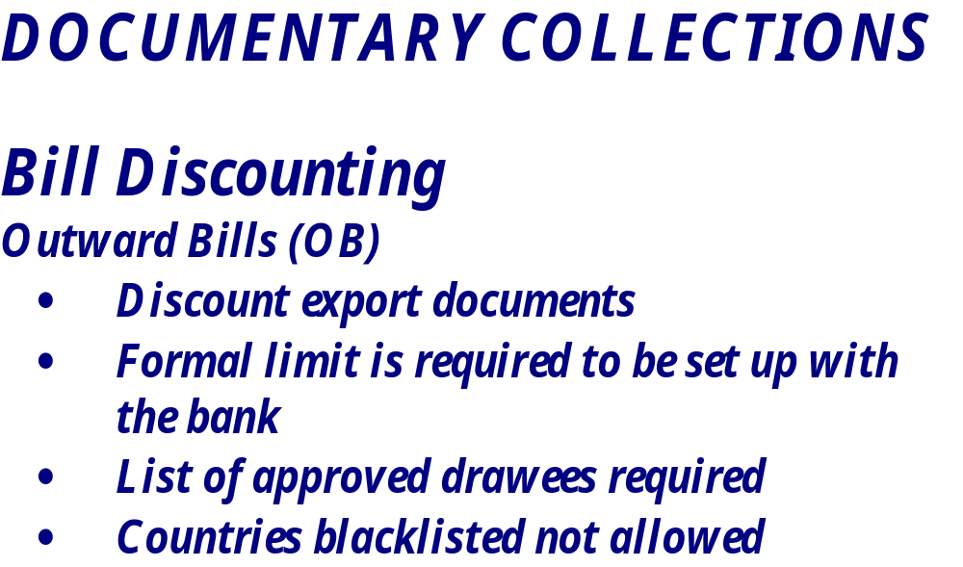
Page 18 /58
TOP GLOVE, TOP QUALITY, TOP EFFICIENCY
GOOD HEALTH, SAFETY FIRST & BE HONEST
Prepared by: Stephy
Date: 11.03.2011

Slide 19
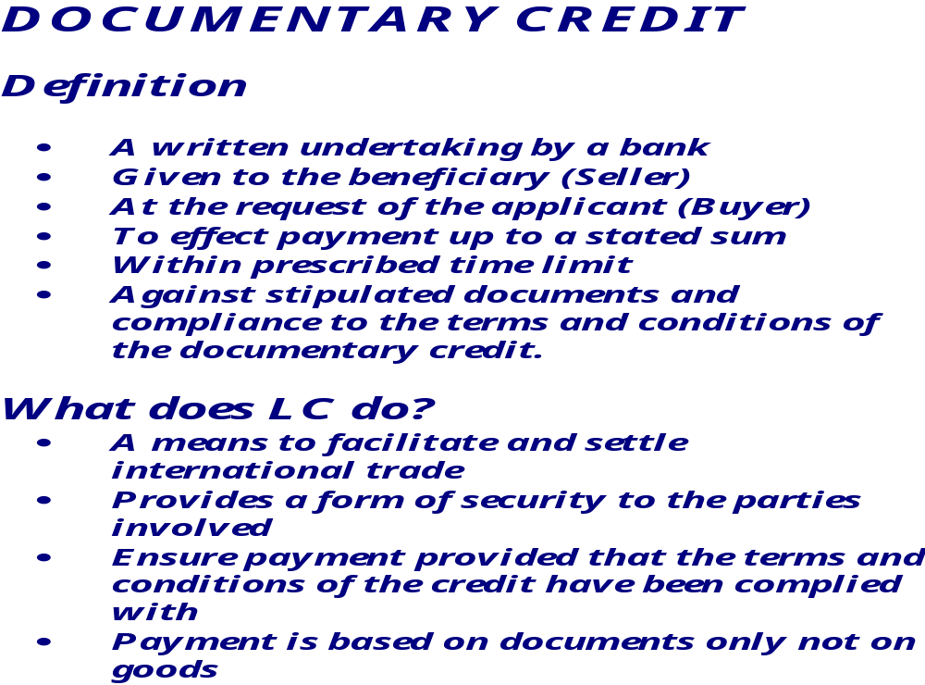
Page 19 /58
TOP GLOVE, TOP QUALITY, TOP EFFICIENCY
GOOD HEALTH, SAFETY FIRST & BE HONEST
Prepared by: Stephy
Date: 11.03.2011

Slide 20


Page 20 /58
TOP GLOVE, TOP QUALITY, TOP EFFICIENCY
GOOD HEALTH, SAFETY FIRST & BE HONEST
Prepared by: Stephy
Date: 11.03.2011
Applicant
Beneficiary
Instruct
Advise
Issuing bank
Advising Bank
Confirming Bank
Open LC

Slide 21
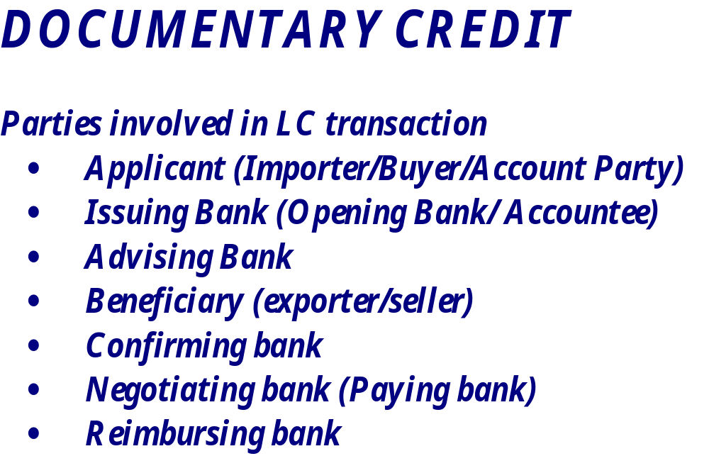
Page 21 /58
TOP GLOVE, TOP QUALITY, TOP EFFICIENCY
GOOD HEALTH, SAFETY FIRST & BE HONEST
Prepared by: Stephy
Date: 11.03.2011

Slide 22
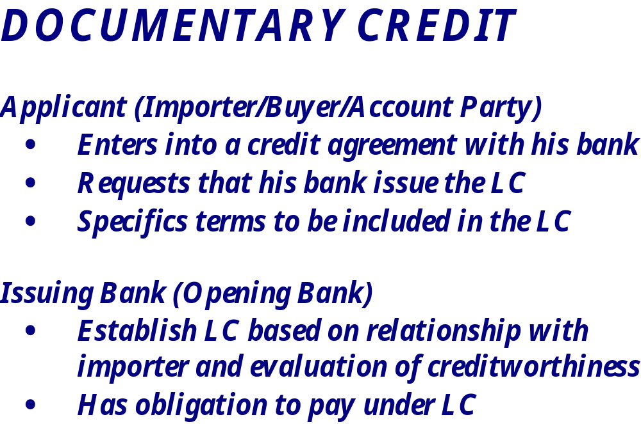
Page 22 /58
TOP GLOVE, TOP QUALITY, TOP EFFICIENCY
GOOD HEALTH, SAFETY FIRST & BE HONEST
Prepared by: Stephy
Date: 10 May 2010

Slide 23
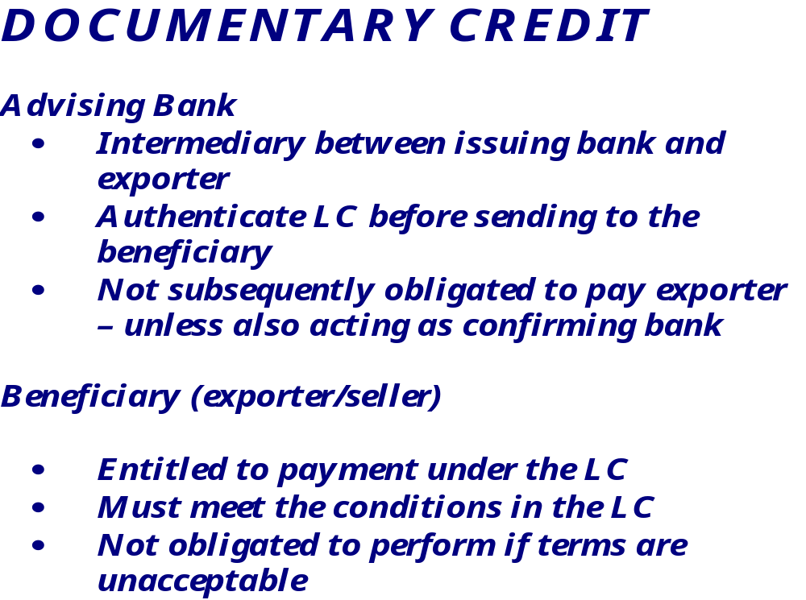
Page 23 /58
TOP GLOVE, TOP QUALITY, TOP EFFICIENCY
GOOD HEALTH, SAFETY FIRST & BE HONEST
Prepared by: Stephy
Date: 11.03.2011

Slide 24
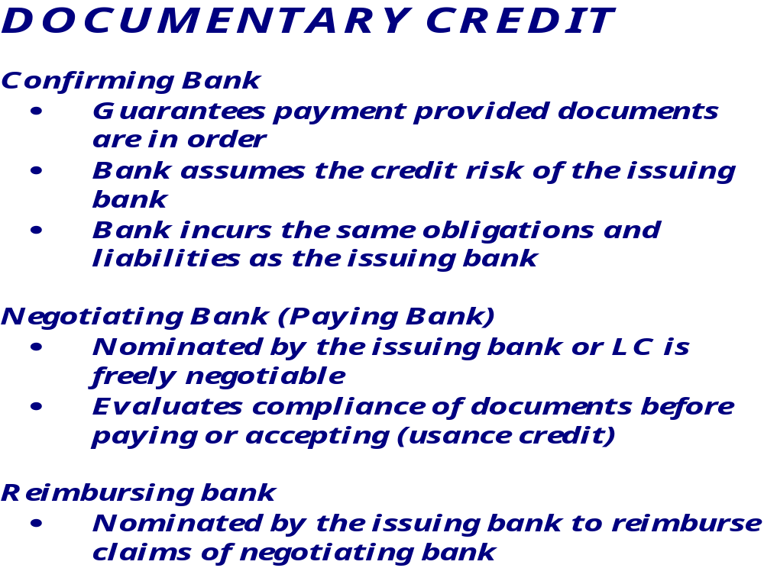
Page 24 /58
TOP GLOVE, TOP QUALITY, TOP EFFICIENCY
GOOD HEALTH, SAFETY FIRST & BE HONEST
Prepared by: Stephy
Date: 11.03.2011

Slide 25
Page 25 /58
TOP GLOVE, TOP QUALITY, TOP EFFICIENCY
GOOD HEALTH, SAFETY FIRST & BE HONEST
Prepared by: Stephy
Date: 11.03.2011
Goods
Beneficiary
Applicant
Applicant will
Documents
ultimately
Cash
Documents
pay Issuing Bank
Documents
Negotiating Bank
Issuing Bank
Reimbursement
Claim
Negotiating Bank either
claims from the issuing
bank or claims from the
reimbursing bank
Reimbursing Bank

Slide 26
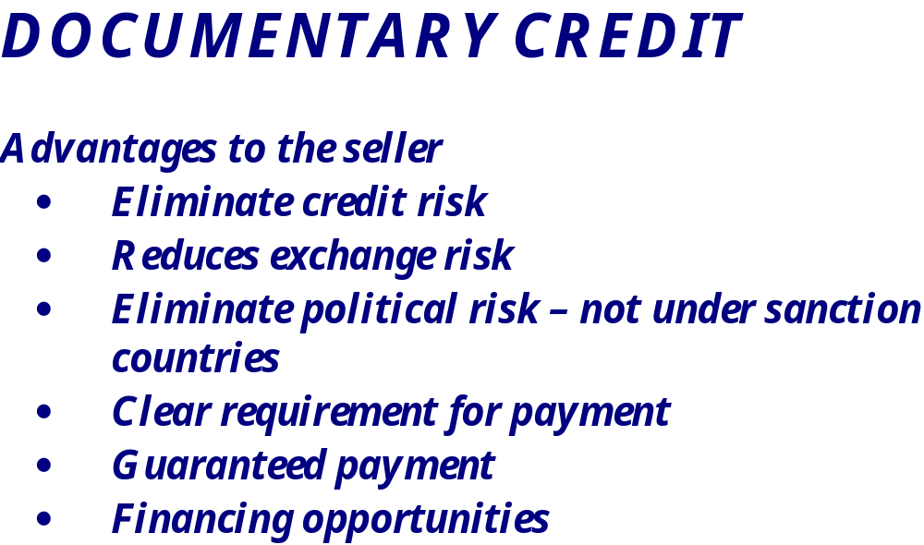
Page 26 /58
Prepared by: Stephy
Date: 11.03.2011
TOP GLOVE, TOP QUALITY, TOP EFFICIENCY
GOOD HEALTH, SAFETY FIRST & BE HONEST

Slide 27
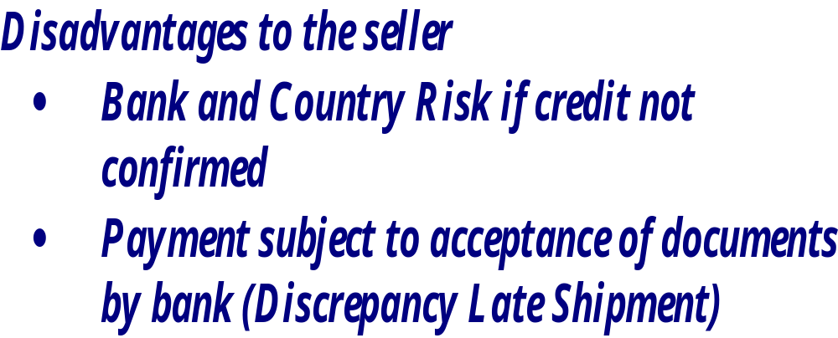
Page 27 /58
TOP GLOVE, TOP QUALITY, TOP EFFICIENCY
GOOD HEALTH, SAFETY FIRST & BE HONEST
Prepared by: Stephy
Date: 11.03.2011

Slide 28
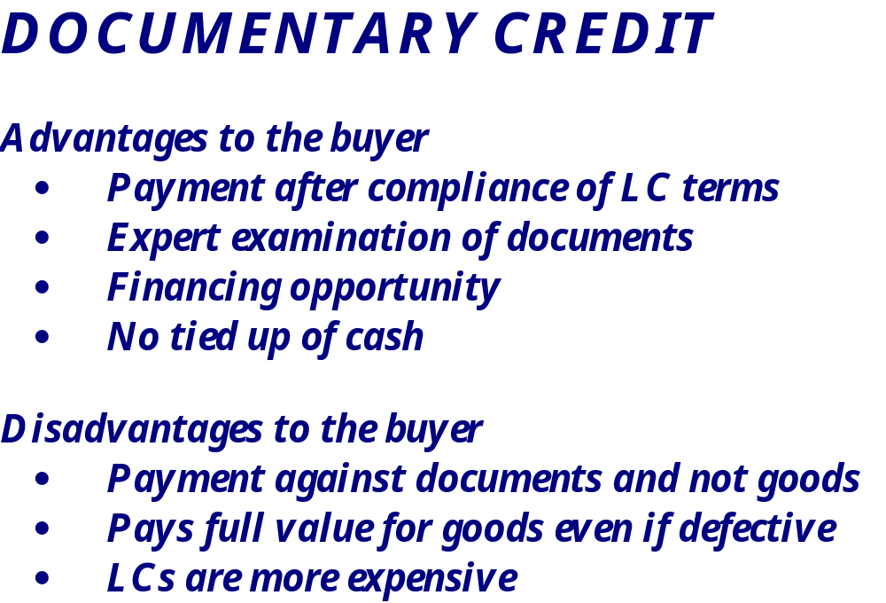
Page 28 /58
TOP GLOVE, TOP QUALITY, TOP EFFICIENCY
GOOD HEALTH, SAFETY FIRST & BE HONEST
Prepared by: Stephy
Date: 11.03.2011

Slide 29
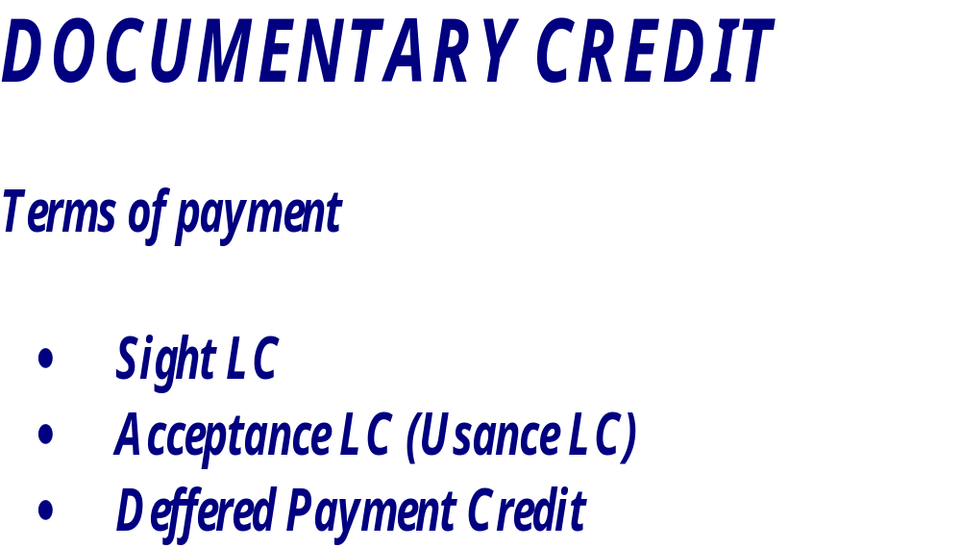
Page 29/58
TOP GLOVE, TOP QUALITY, TOP EFFICIENCY
GOOD HEALTH, SAFETY FIRST & BE HONEST
Prepared by: Stephy
Date: 11.03.2011

Slide 30
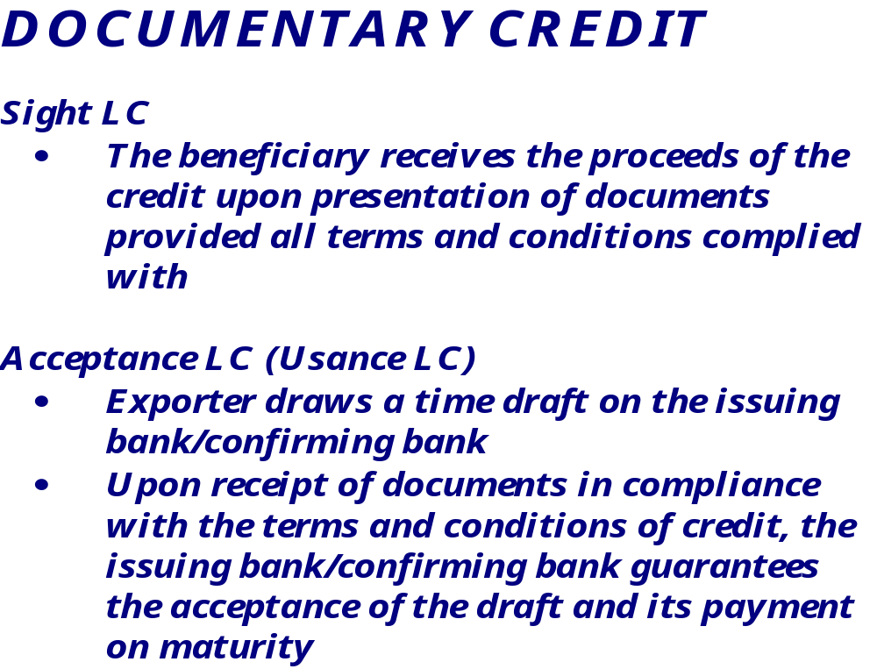
Page 30 /58
TOP GLOVE, TOP QUALITY, TOP EFFICIENCY
GOOD HEALTH, SAFETY FIRST & BE HONEST
Prepared by: Stephy
Date: 11.03.2011
Notes:
Page 1 / 58

Slide 31
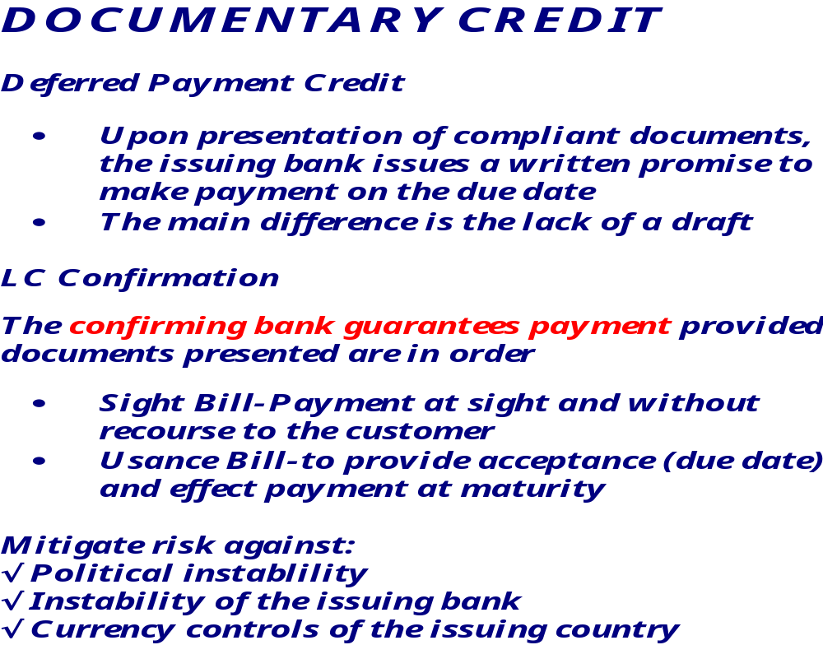
Page 31 /58
TOP GLOVE, TOP QUALITY, TOP EFFICIENCY
GOOD HEALTH, SAFETY FIRST & BE HONEST
Prepared by: Stephy
Date: 11.03.2011

Slide 32
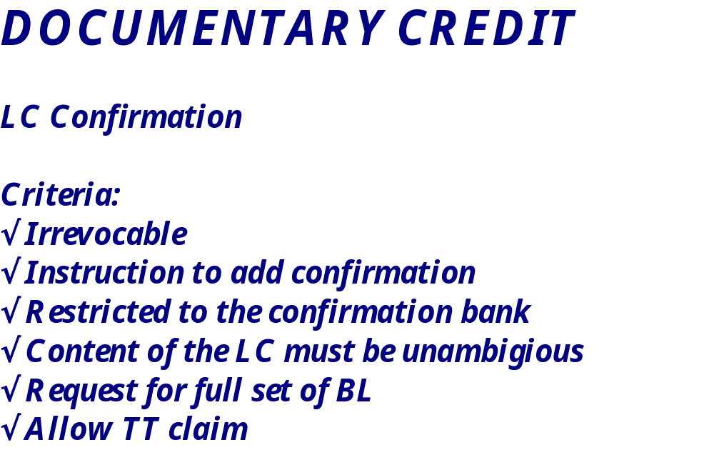
Page 32 /58
TOP GLOVE, TOP QUALITY, TOP EFFICIENCY
GOOD HEALTH, SAFETY FIRST & BE HONEST
Prepared by: Stephy
Date: 11.03.2011

Slide 33
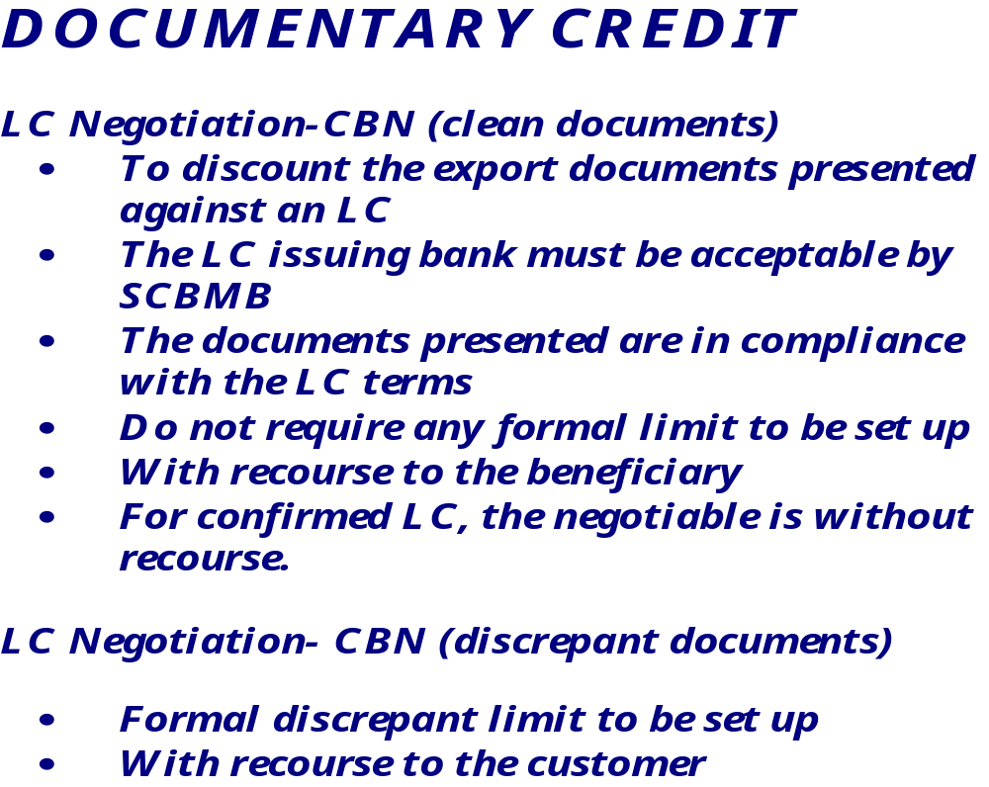
Page 33 /58
TOP GLOVE, TOP QUALITY, TOP EFFICIENCY
GOOD HEALTH, SAFETY FIRST & BE HONEST
Prepared by: Stephy
Date: 11.03.2011

Slide 34
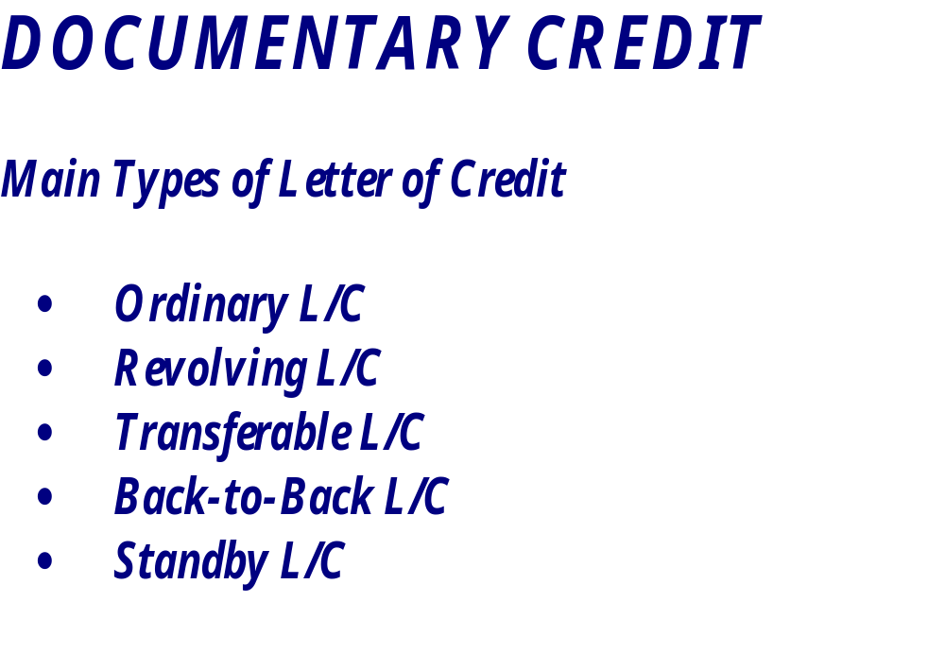
Page 34 /58
TOP GLOVE, TOP QUALITY, TOP EFFICIENCY
GOOD HEALTH, SAFETY FIRST & BE HONEST
Prepared by: Stephy
Date: 11.03.2011

Slide 35
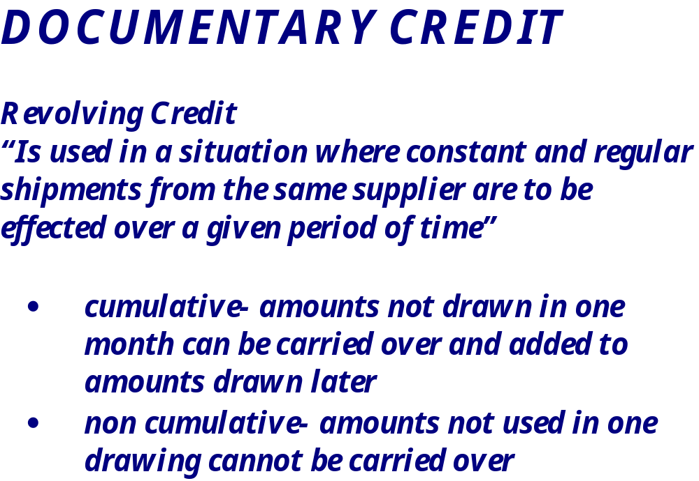
Page 35 /58
TOP GLOVE, TOP QUALITY, TOP EFFICIENCY
GOOD HEALTH, SAFETY FIRST & BE HONEST
Prepared by: Stephy
Date: 11.03.2011

Slide 36
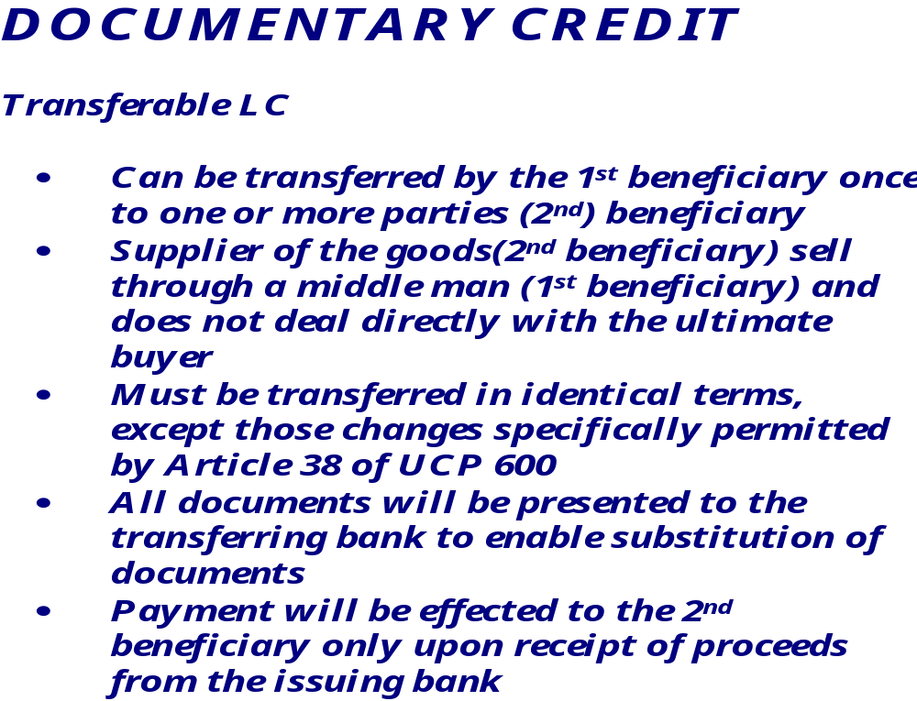
Page 36 /58
TOP GLOVE, TOP QUALITY, TOP EFFICIENCY
GOOD HEALTH, SAFETY FIRST & BE HONEST
Prepared by: Stephy
Date: 11.03.2011

Slide 37

Page 37 /58
TOP GLOVE, TOP QUALITY, TOP EFFICIENCY
GOOD HEALTH, SAFETY FIRST & BE HONEST
Prepared by: Stephy
Date: 11.03.2011

Slide 38
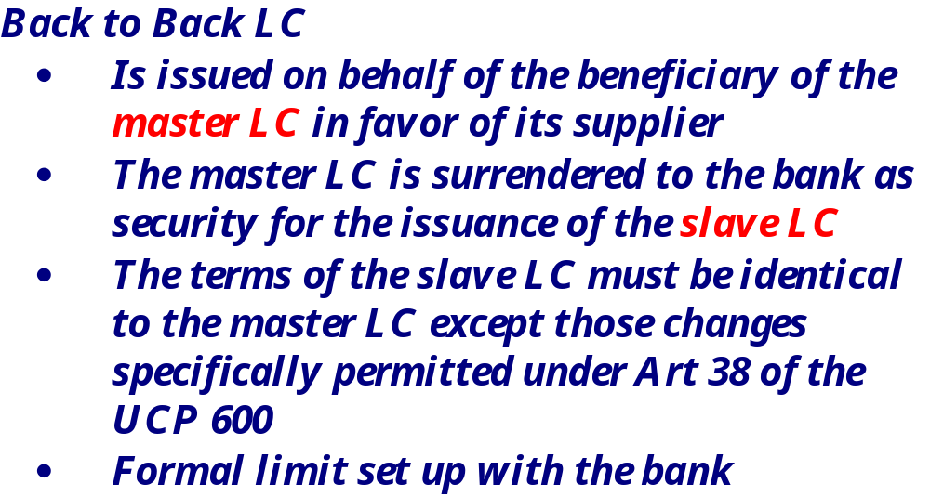
Page 38 /58
TOP GLOVE, TOP QUALITY, TOP EFFICIENCY
GOOD HEALTH, SAFETY FIRST & BE HONEST
Prepared by: Stephy
Date: 11.03.2011

Slide 39
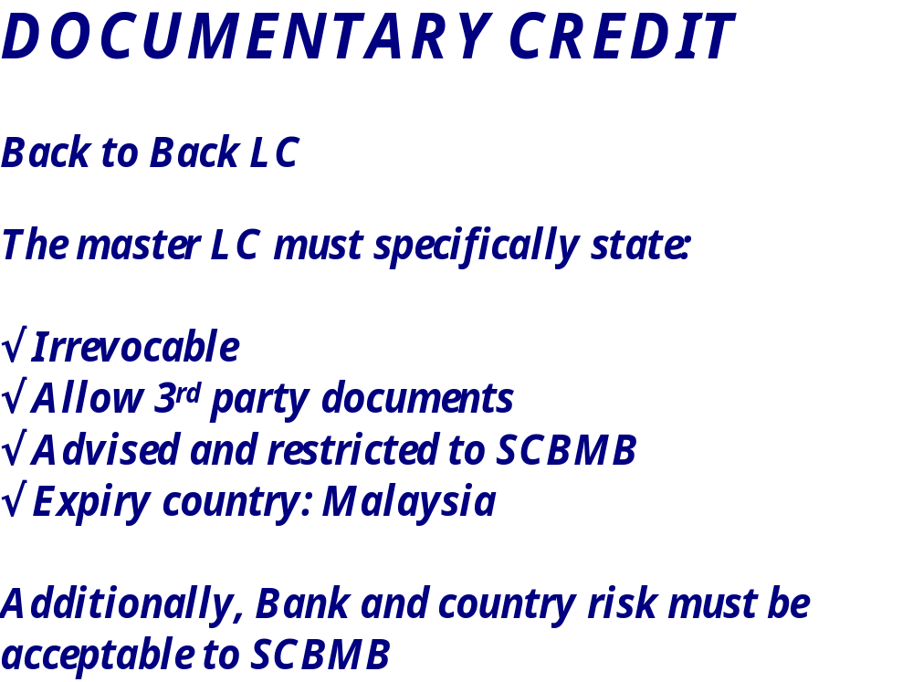
Page 39 /58
TOP GLOVE, TOP QUALITY, TOP EFFICIENCY
GOOD HEALTH, SAFETY FIRST & BE HONEST
Prepared by: Stephy
Date: 11.03.2011

Slide 40
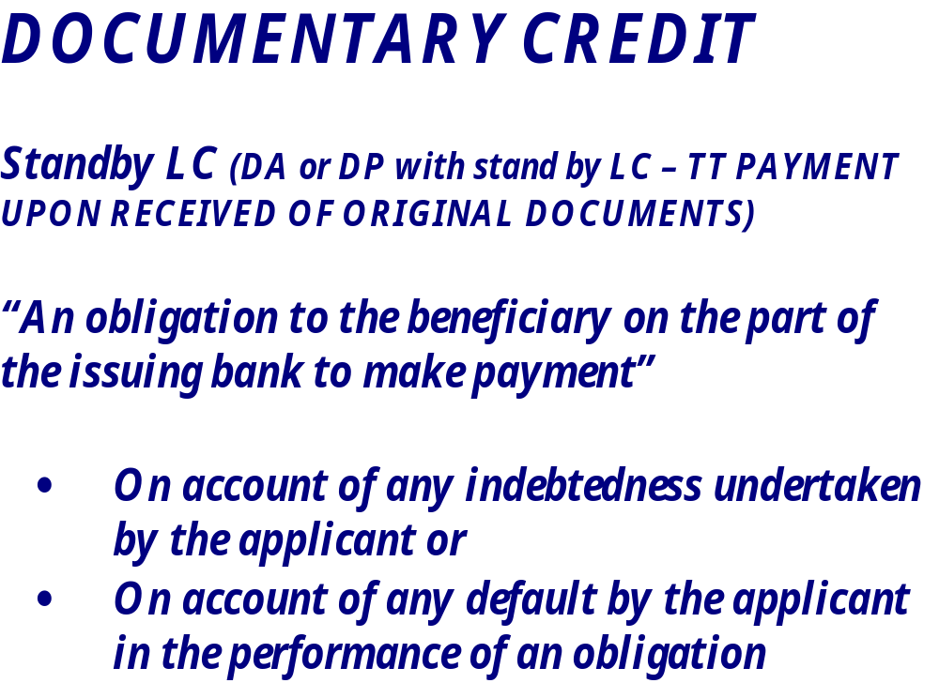
Page 40 /58
TOP GLOVE, TOP QUALITY, TOP EFFICIENCY
GOOD HEALTH, SAFETY FIRST & BE HONEST
Prepared by: Stephy
Date: 11.03.2011

Slide 41
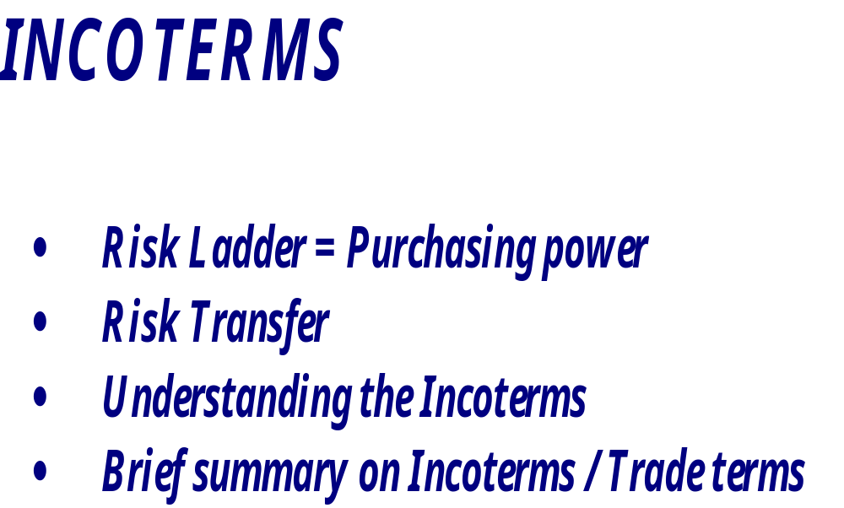
Page 41 /58
TOP GLOVE, TOP QUALITY, TOP EFFICIENCY
GOOD HEALTH, SAFETY FIRST & BE HONEST
Prepared by: Stephy
Date: 11.03.2011

Slide 42


Page 42 /58
TOP GLOVE, TOP QUALITY, TOP EFFICIENCY
GOOD HEALTH, SAFETY FIRST & BE HONEST
Prepared by: Stephy
Date: 11.03.2011
EXPORTER’S RISK
HIGHER RISK
IMPORTER’S RISK
OPEN ACCOUNT
ADVANCE PAYMENT
D/P & D/A COLLECTION
LETTER OF CREDIT
LETTER OF CREDIT
D/P & D/A COLLECTION
ADVANCE PAYMENT
OPEN ACCOUNT
LOWER RISK

Slide 43
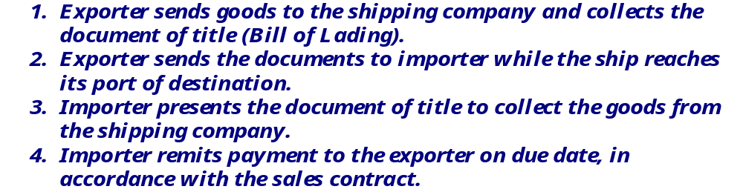
Page 43 /58
TOP GLOVE, TOP QUALITY, TOP EFFICIENCY
GOOD HEALTH, SAFETY FIRST & BE HONEST
Prepared by: Stephy
Date: 11.03.2011
3
Bill of lading
IMPORTER
SHIPPING CO
2
Payment
Documents
4
1
Goods
EXPORTER
SHIPPING CO
Bill of lading

Slide 44
Page 44 /58
TOP GLOVE, TOP QUALITY, TOP EFFICIENCY
GOOD HEALTH, SAFETY FIRST & BE HONEST
Prepared by: Stephy
Date: 11.03.2011
Incoterms | Costs |  |  | Export Formalities | Import Formalities: | Risks passes to buyer when: | Insurance Obligation
 | Loading | Freight | Unloading
Ex-Work (EXW) | Buyer (responsible for loading the collecting vehicles from seller’s premises) | Buyer | Buyer | Buyer | Buyer | Seller makes goods available at his premises | Neither party has an obligation, but in the buyer’s interest to insure goods

Slide 45
Page 45 /58
TOP GLOVE, TOP QUALITY, TOP EFFICIENCY
GOOD HEALTH, SAFETY FIRST & BE HONEST
Prepared by: Stephy
Date: 11.03.2011
Incoterms | Costs |  |  | Export Formalities | Import Formalities: | Risks passes to buyer when: | Insurance Obligation
 | Loading | Freight | Unloading
Free On Board (FOB) Suitable only for sea or inland waterway transport | Seller is responsible for loading on to the vessel nominated by the buyer | Buyer | Buyer | Seller | Seller | Seller delivers the goods across the rails of the ship nominated by buyer | Neither party has an obligation, but it is in the buyer’s interest to insure goods for the transit period

Slide 46
Page 46 /58
TOP GLOVE, TOP QUALITY, TOP EFFICIENCY
GOOD HEALTH, SAFETY FIRST & BE HONEST
Prepared by: Stephy
Date: 11.03.2011
Incoterms | Costs |  |  | Export Formalities | Import Formalities: | Risks passes to buyer when: | Insurance Obligation
 | Loading | Freight | Unloading
Cost and Freight (CFR) – Suitable only for sea and inland waterway transport | Seller is responsible for loading on to the vessel nominated by buyer | Seller | Buyer | Seller | Buyer | Seller delivers the goods across the rails of the ship nominated by buyer | Neither party has an obligation, but in the buyer’s interest to insure goods for the transit period

Slide 47
Page 47 /58
TOP GLOVE, TOP QUALITY, TOP EFFICIENCY
GOOD HEALTH, SAFETY FIRST & BE HONEST
Prepared by: Stephy
Date: 11.03.2011
Incoterms | Costs |  |  | Export Formalities | Import Formalities: | Risks passes to buyer when: | Insurance Obligation
 | Loading | Freight | Unloading
Cost, Insurance and Freight (CIF) – Suitable only for sea and inland waterway transport | Seller is responsible for loading on to the vessel nominated by buyer | Seller | Buyer | Seller | Buyer | Seller delivers the goods across the rails of the ship nominated by buyer | Seller, however only required to provide min cover. Should buyer need greater coverage- to state in contract or arrange himself

Slide 48
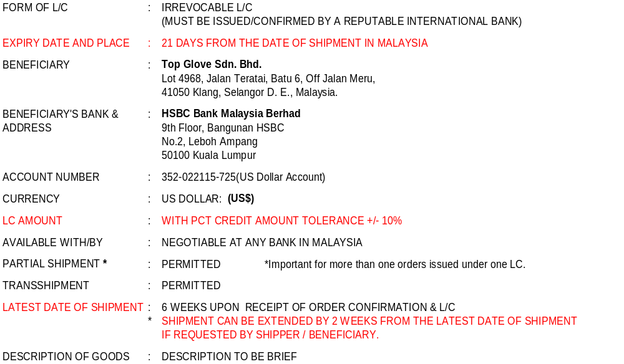
Page 48 /58
TOP GLOVE, TOP QUALITY, TOP EFFICIENCY
GOOD HEALTH, SAFETY FIRST & BE HONEST
Prepared by: Stephy
Date: 11.03.2011

Slide 49
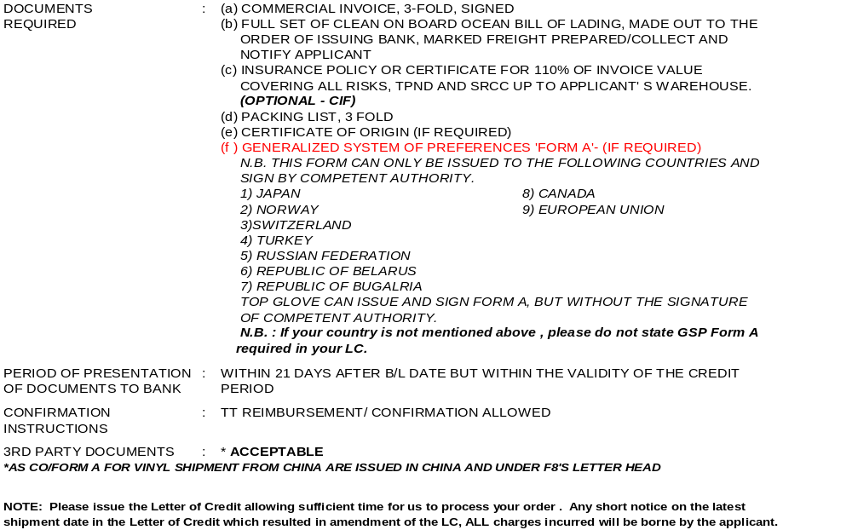
Page 49 /58
TOP GLOVE, TOP QUALITY, TOP EFFICIENCY
GOOD HEALTH, SAFETY FIRST & BE HONEST
Prepared by: Stephy
Date: 11.03.2011

Slide 50
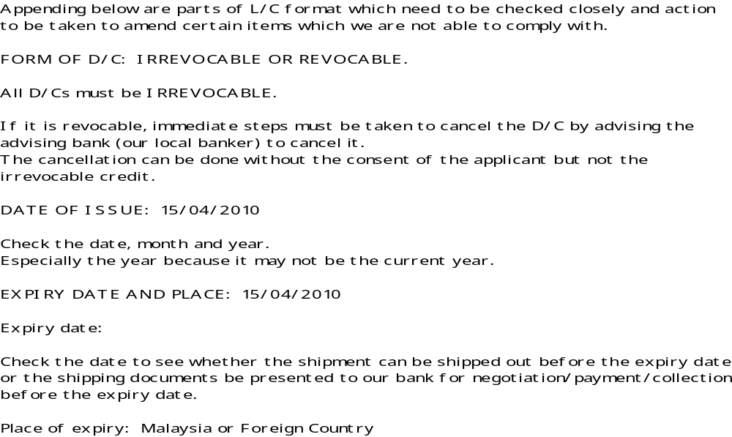
Page 50 /58
TOP GLOVE, TOP QUALITY, TOP EFFICIENCY
GOOD HEALTH, SAFETY FIRST & BE HONEST
Prepared by: Stephy
Date: 11.03.2011

Slide 51
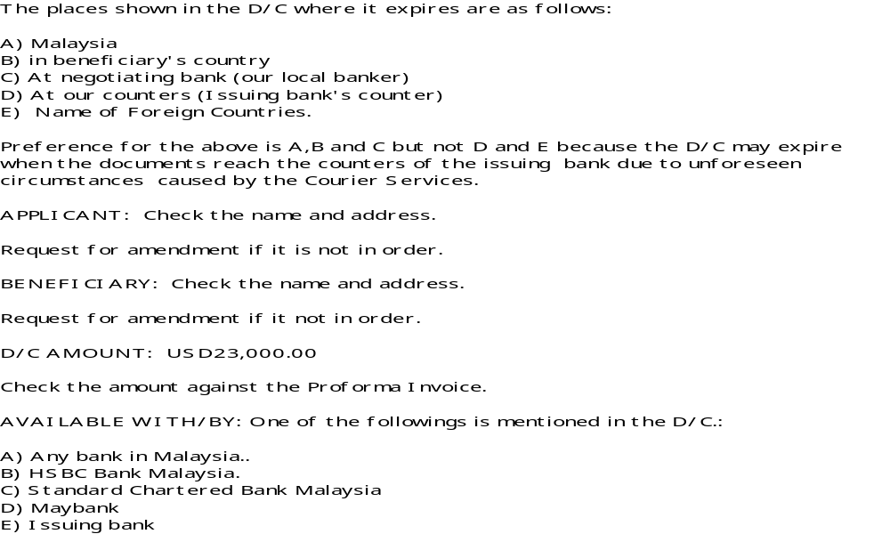
Page 51 /58
TOP GLOVE, TOP QUALITY, TOP EFFICIENCY
GOOD HEALTH, SAFETY FIRST & BE HONEST
Prepared by: Stephy
Date: 11.03.2011

Slide 52
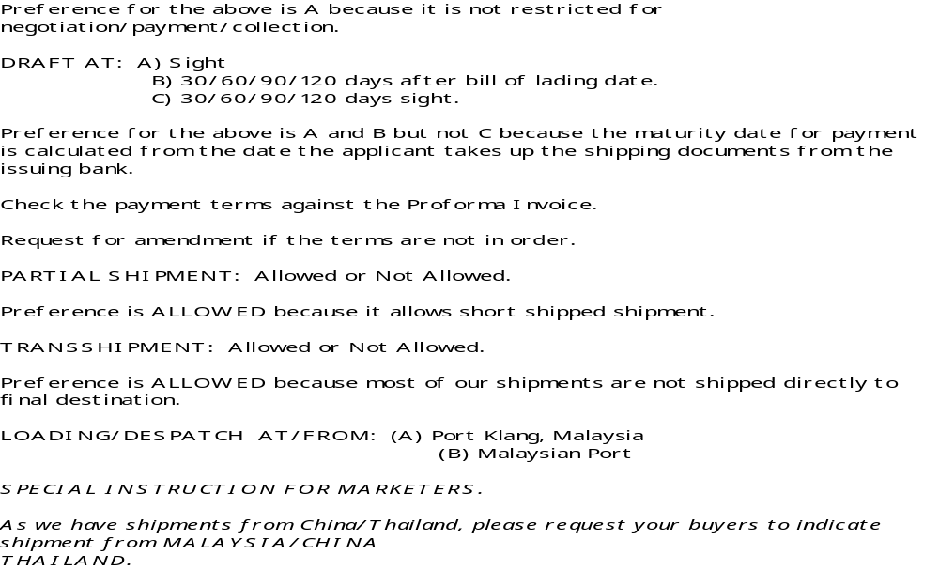
Page 52 /58
TOP GLOVE, TOP QUALITY, TOP EFFICIENCY
GOOD HEALTH, SAFETY FIRST & BE HONEST
Prepared by: Stephy
Date: 11.03.2011

Slide 53
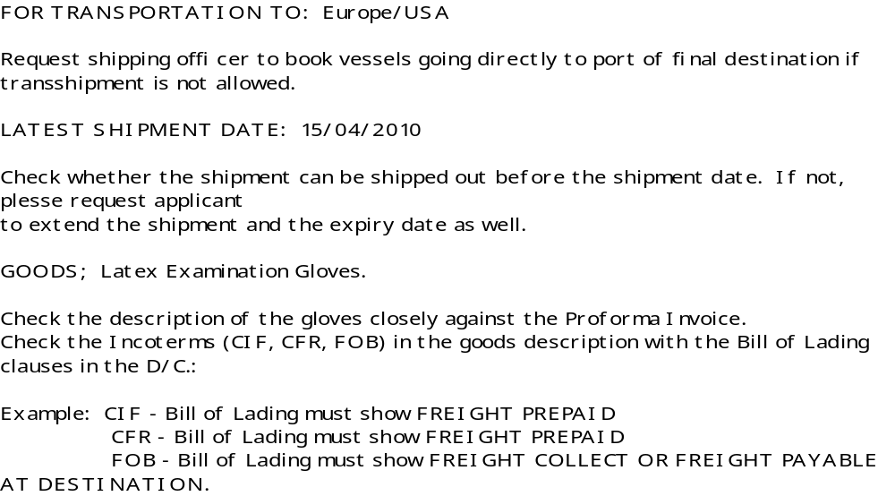
Page 53 /58
TOP GLOVE, TOP QUALITY, TOP EFFICIENCY
GOOD HEALTH, SAFETY FIRST & BE HONEST
Prepared by: Stephy
Date: 11.03.2011

Slide 54
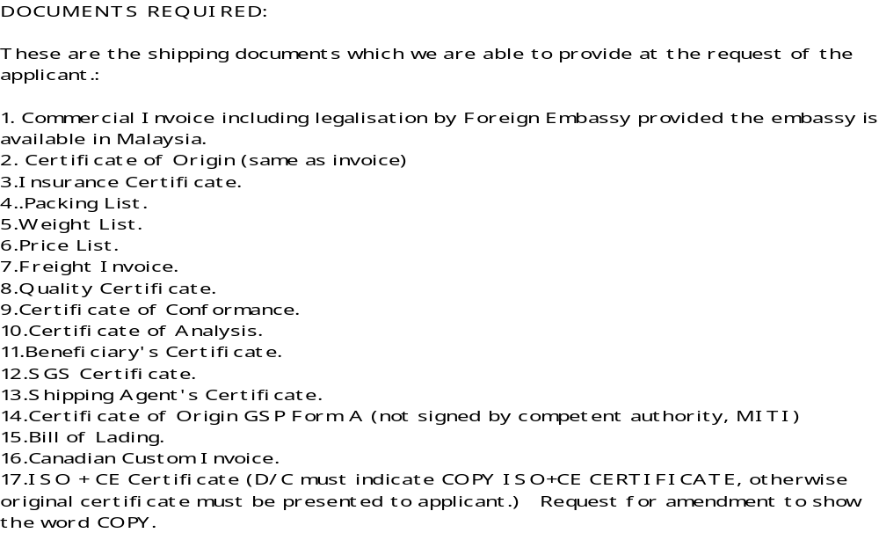
Page 54 /58
TOP GLOVE, TOP QUALITY, TOP EFFICIENCY
GOOD HEALTH, SAFETY FIRST & BE HONEST
Prepared by: Stephy
Date: 11.03.2011

Slide 55
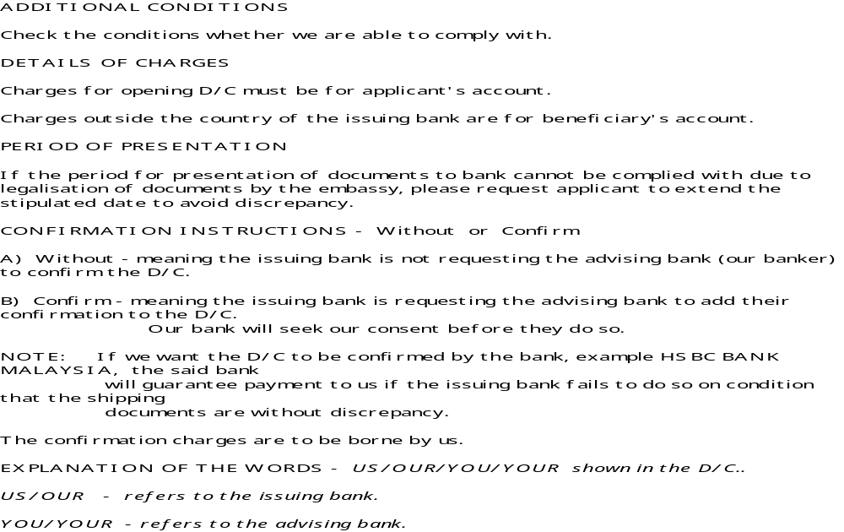
Page 55 /58
TOP GLOVE, TOP QUALITY, TOP EFFICIENCY
GOOD HEALTH, SAFETY FIRST & BE HONEST
Prepared by: Stephy
Date: 11.03.2011

Slide 56

Page 56 /58
Prepared by: Stephy
Date: 11.03.2011
TOP GLOVE, TOP QUALITY, TOP EFFICIENCY
GOOD HEALTH, SAFETY FIRST & BE HONEST

